Slide 1
Presentation for Progress Report 2
Team: Henry Reichard, Matthew Malzahn, Mikael Williams

Slide 2
Roles
Backend: Henry Reichard
Frontend: Mikael Williams and Matthew Malzahn

Slide 3
Environment
Backend: Running Amazon Linux 2 Server through Amazon AWS, EC2 Instance
Database is through LAMPS with MariaDB
Database can be accessed through phpMyAdmin through this link
Server is running AWS EC2 Instancing with Amazon Linux 2
Server can be accessed through terminal
Frontend:
Creation using HTML/Bootstrap and CSS to create elegant interface
Front end will be coded through Notepad++ and PhpStorm
Front end web pages can be accessed through this link

Slide 4
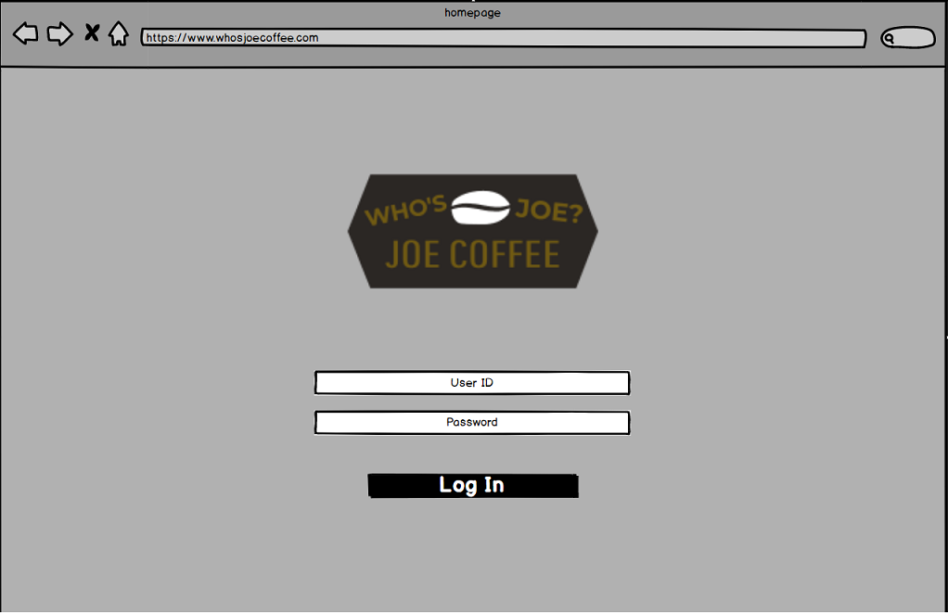
GUI

Slide 5
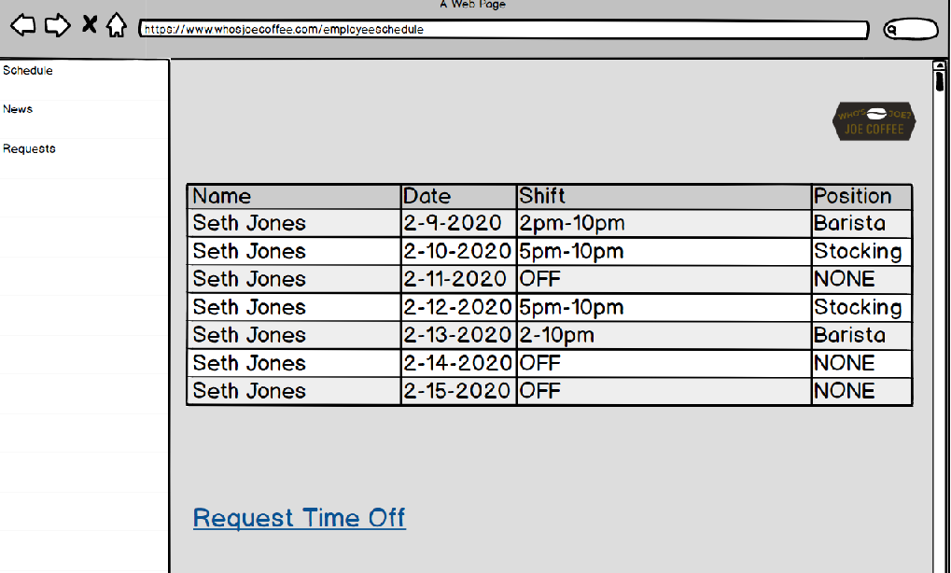
More GUI

Slide 6
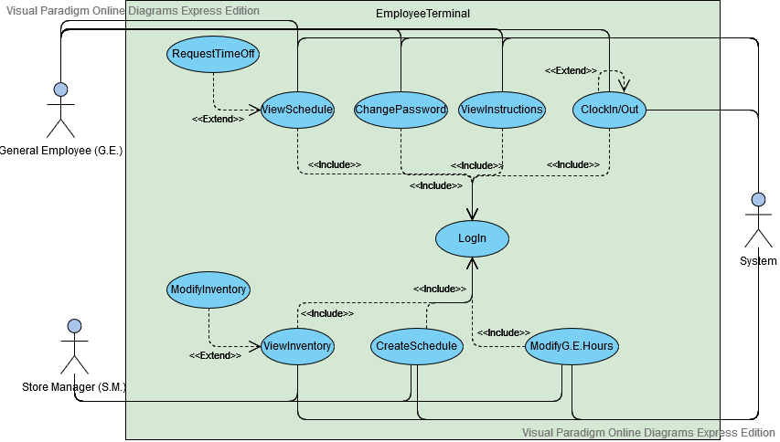
Use Case Diagram

Slide 7
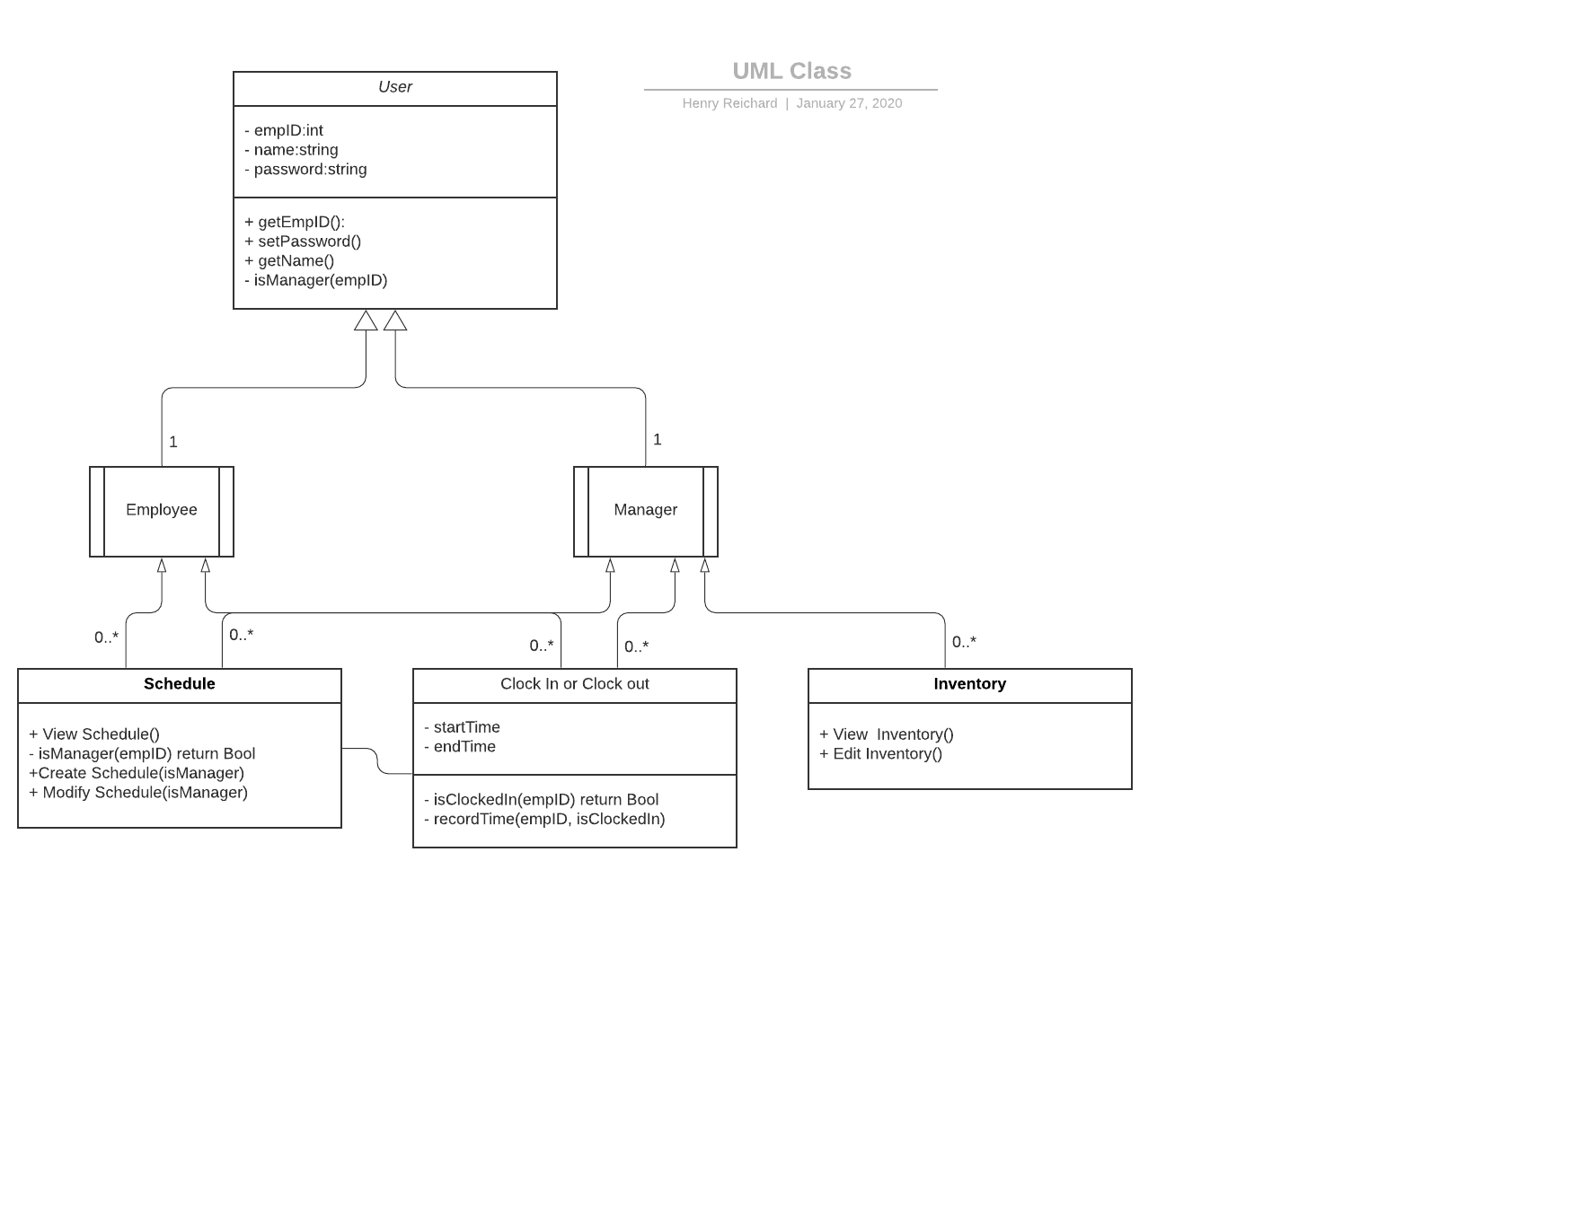
UML Class Diagram

Slide 8
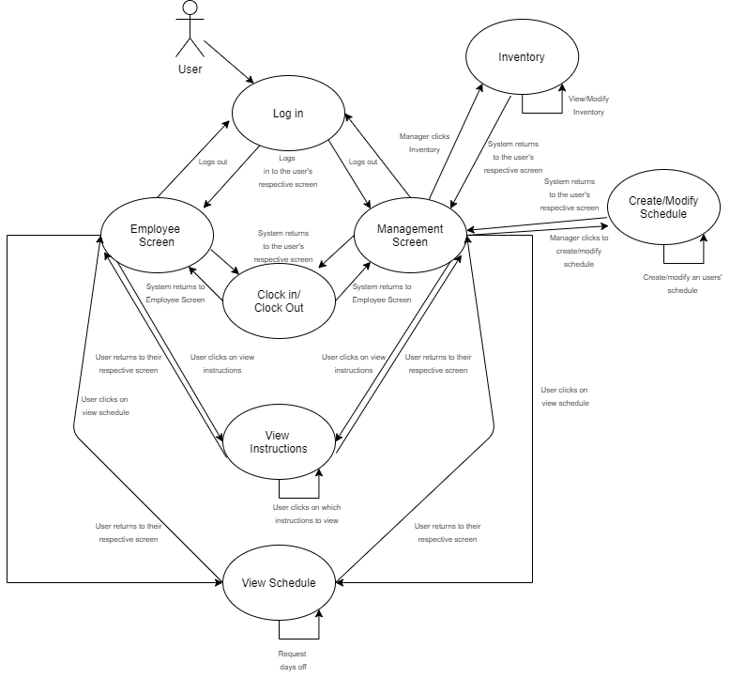
State Diagram

Slide 9
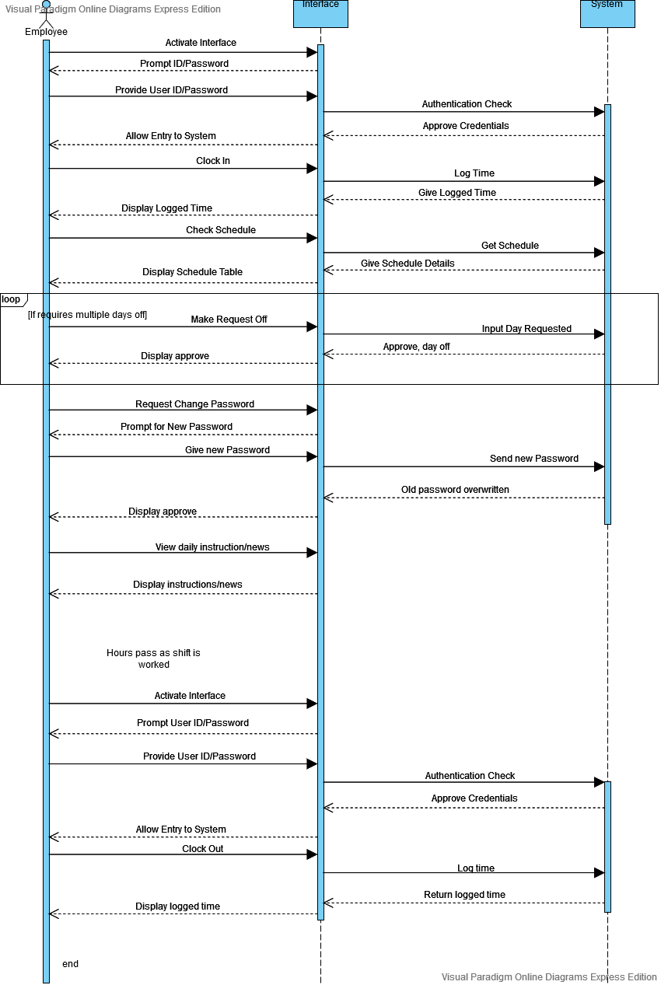
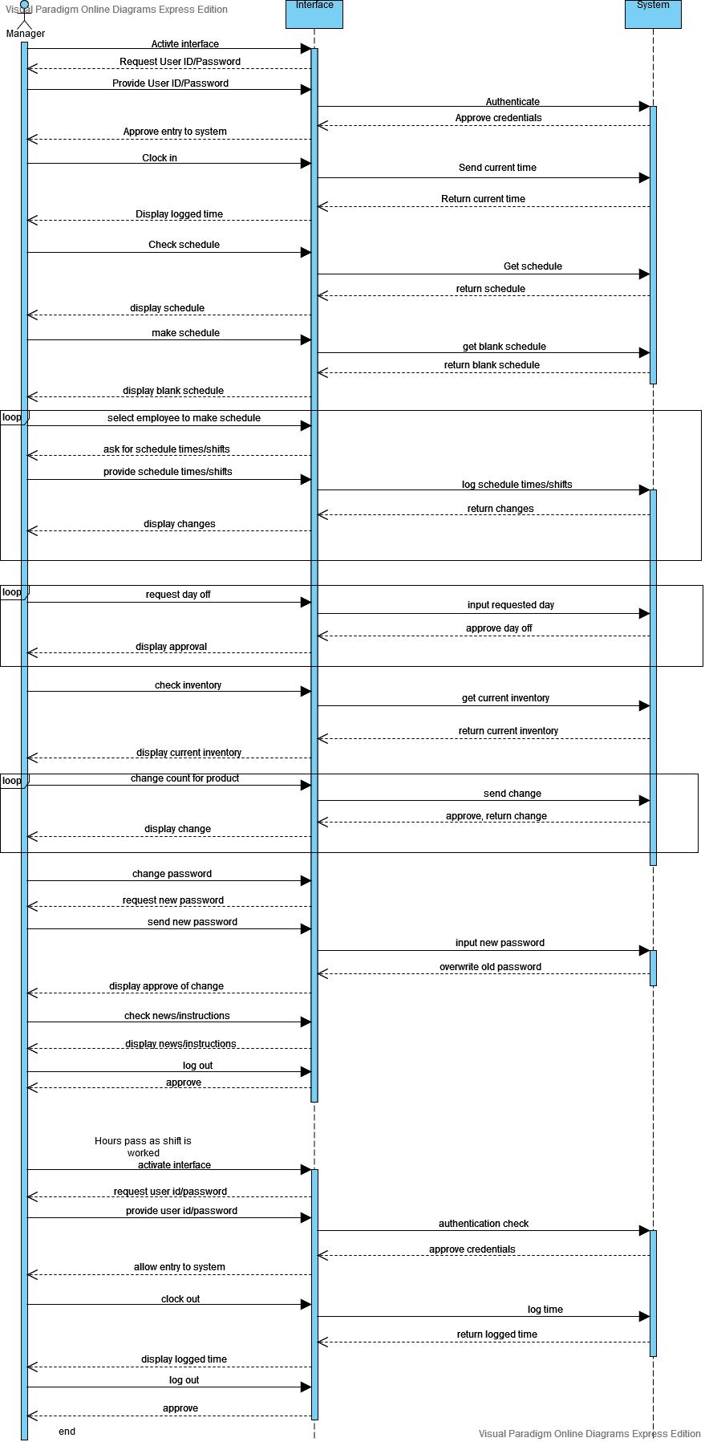
Sequence Diagram
Employee Sequence Diagram
Manager Sequence Diagram

Slide 10
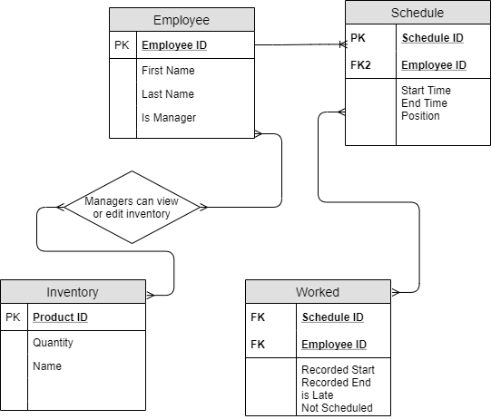
ER Model (needs further updating)

Slide 11
Questions?

